Slide 1
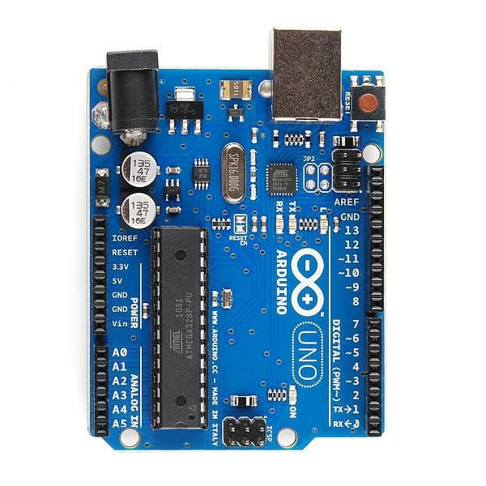
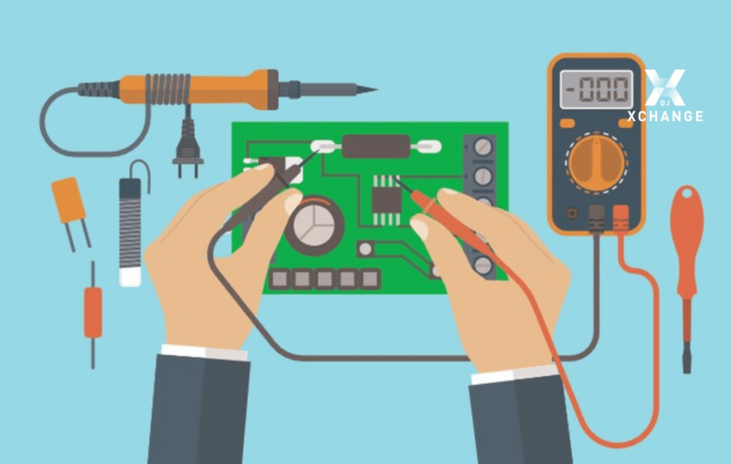
BASICS OF ELECTRONICS & INTRODUCTION ABOUT ARDUINO

Slide 2
CONTENT
Voltage & Current
Resistor
LEDs
Arduino
Breadboard
Motor
IR Sensor
Arduino UNO
Arduino Programming Basics
Q&A

Slide 3
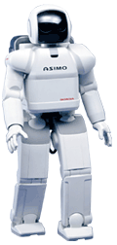
WHAT IS ROBOT ?
A robot is a mechanical device that can perform tasks automatically. It may – but need not – be humanoid in appearance. Some robots require some degree of guidance, which may be done using a remote control, or with a computer interface. A robot is usually an electro-mechanical machine that is guided by a program or circuitry.

Slide 4
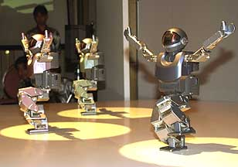
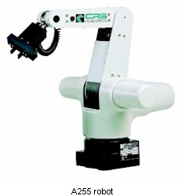
WHAT IS ROBOTICS ?
The branch of technology that deals with the design, construction, operation, and application of robots.

Slide 5

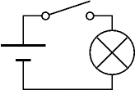

VOLTAGE & CURRENT
Voltage and Current are vital to understanding electronics, but they are quite hard to grasp because we can't see them directly.
Voltage is the Cause, Current is the Effect
Voltage and Current The switch is closed making a complete circuit so current can flow.
Voltage but No Current The switch is open so the circuit is broken and current cannot flow.
No Voltage and No Current Without the cell there is no source of voltage so current cannot flow

Slide 7
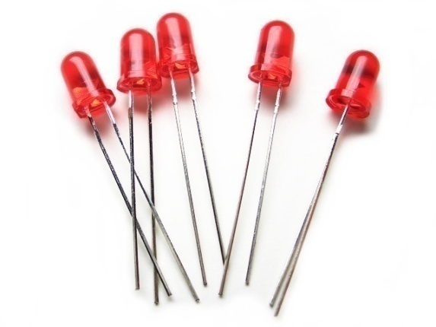

LED
A light-emitting diode (LED) is a semiconductor light source. LEDs are used as indicator lamps in many devices and are increasingly used for other lighting.
Electronic Symbol

Slide 8
SENSORS
Definition: Sensor is an input device which provides an output (signal) with respect to a specific physical quantity (input).
The term “input device” in the definition of a Sensor means that it is part of a bigger system which provides input to a main control system (like a Processor or a Microcontroller).
We live in a World of Sensors. You can find different types of Sensors in our homes, offices, cars etc. working to make our lives easier by turning on the lights by detecting our presence, adjusting the room temperature, detect smoke or fire, make us delicious coffee, open garage doors as soon as our car is near the door and many other tasks.

Slide 9
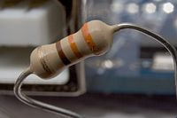

RESISTORS
A resistor is a passive two-terminal electrical component that implements electrical resistance as a circuit element.
The current through a resistor is in direct proportion to the voltage across the resistor's terminals. According to Ohm’s Law
I → current through the conductor in units of Amperes (A)
V→ Voltage measured across the conductor in units of Volts(V)
R→ resistance of the conductor in units of Ohms (Ω).

Slide 10
RESISTORS COLORS

Slide 11
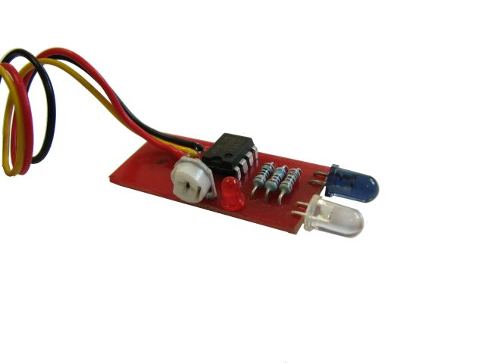


IR SENSOR
IR Sensor is a detector which reacts to a infrared radiations.
IR Sensor Pair:
Transmitter = LED (Light Emitting Diode)
It is similar to normal LEDs but emit infra-red light its glow can be seen with a digital camera or mobile phone camera.
Receiver = Photodiode/IR Transistor. A photodiode is a diode that conducts only when light falls on it.

Slide 12

IR SENSOR WORKING
Working →
Object / Line
IR sensor Pair
Transmitter (Tx)
Receiver (Rx)
Transmitter = LED (Light Emitting Diode)
Receiver = Photodiode
12

Slide 13
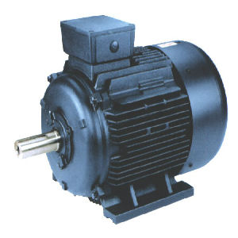
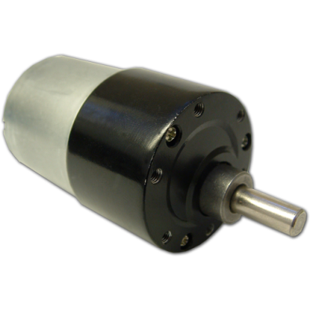
MOTORS
An electric motor is an electromechanical device that converts electrical energy into mechanical energy.
There are two types of motor:
AC Motors (Run on AC Electric Power).
DC Motors (Run on DC Electric Power).
DC Motor
AC Motor

Slide 14
MOTOR DRIVER (H-BRIDGE) L293D
Motor driver circuit (L293D) is used to drive the motor in Forward or Reverse Direction.
M1a | M1b | Motor State
0 | 0 | Stop
1 | 0 | Forward
0 | 1 | Reverse
1 | 1 | Stop

Slide 15
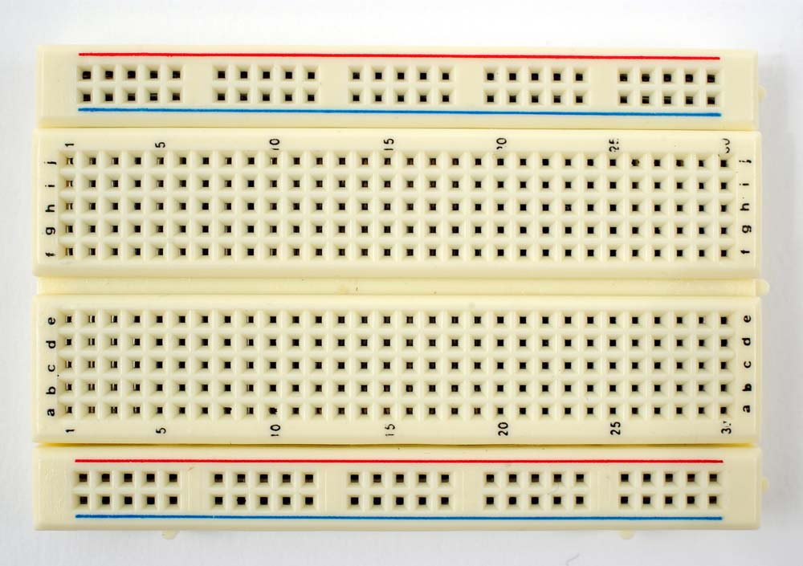
BREADBOARD
A breadboard (or protoboard) is usually a construction base for prototyping of electronics.
The term "breadboard" is commonly used to refer to a solderless breadboard (plugboard).

Slide 16
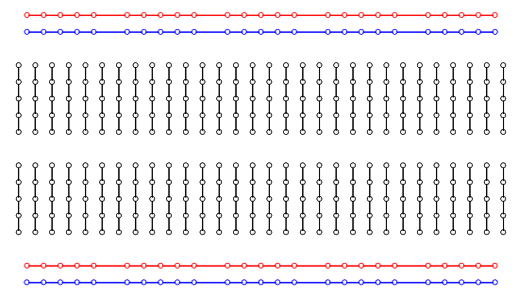
INTERNAL DIAGRAM OF BREADBOARD

Slide 17
ARDUINO
Arduino is an open-source electronics prototyping platform based on flexible, easy-to-use hardware and software. It's intended for artists, designers, hobbyists, and anyone interested in creating interactive objects or environments.

Slide 18
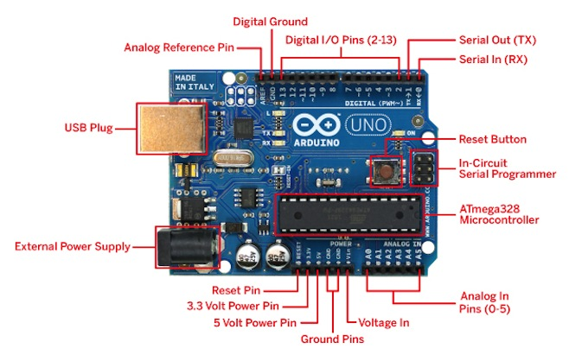

Slide 19
ARDUINO PROGRAMMING BASICS
digitalWrite()
analogWrite()
digitalRead()
if() statements / Boolean
analogRead()
Serial communication
BIG 6 CONCEPTS

Slide 20

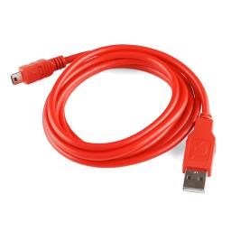
ARDUINO CONNECTION WITH COMPUTER

Slide 21

CONCEPTS: INPUT VS. OUTPUT
Referenced from the perspective of the microcontroller (electrical board).
Inputs is a signal / information going into the board.
Output is any signal exiting the board.
Almost all systems that use physical computing will have some form of output
What are some examples of Outputs?
Examples: Buttons Switches, Light Sensors, Flex Sensors, Humidity Sensors, Temperature Sensors…
Examples: LEDs, DC motor, servo motor, a piezo buzzer, relay, an RGB LED

Slide 22
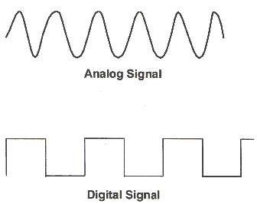
CONCEPTS: ANALOG VS. DIGITAL
Microcontrollers are digital devices – ON or OFF. Also called – discrete.
analog signals are anything that can be a full range of values. What are some examples? More on this later…
5 V
5 V
0 V
0 V

Slide 23
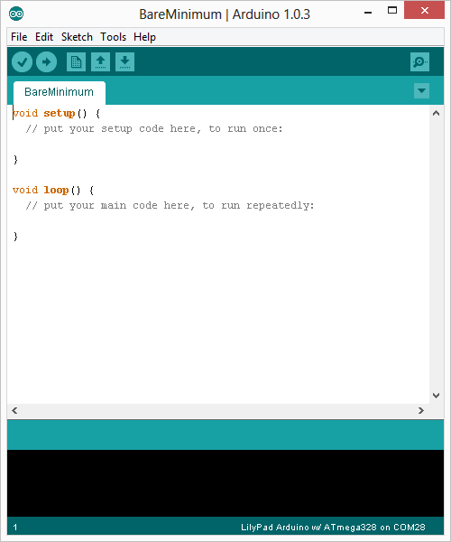
ARDUINO INTEGRATED DEVELOPMENT ENVIRONMENT (IDE)
Two required functions / methods / routines:
void setup()
{
// runs once
}
void loop()
{
// repeats
}
error & status messages

Slide 24
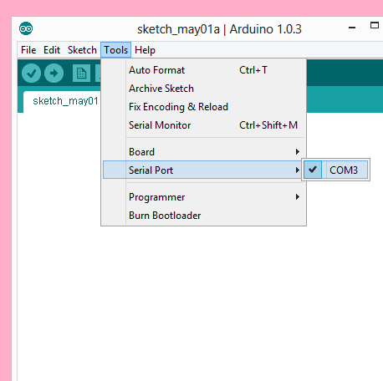
SETTINGS: TOOLS → SERIAL PORT
Your computer communicates to the Arduino microcontroller via a serial port → through a USB-Serial adapter.
Check to make sure that the drivers are properly installed.

Slide 25
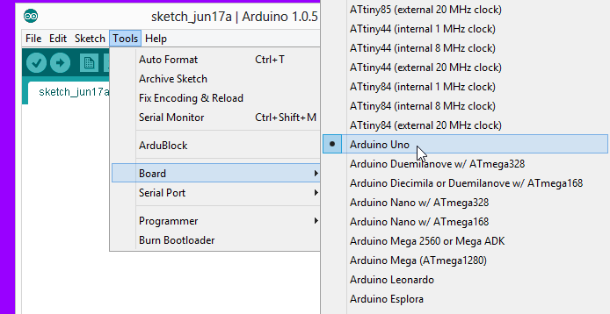
SETTINGS: TOOLS → BOARD
Next, double-check that the proper board is selected under the Tools→Board menu.

Slide 26
THANK YOU

